Slide 1
DAY-OF PRIMER

Slide 2
#GOALS
Learn about all the fun stuff happening on November 17 that your org can plug into
Connect the why to what you’re doing during ExtraGive
Learn some best practices for on-the-day engagement
Familiarize yourself with the ExtraGive tools we have for you!

Slide 4
GIVE DAY BREAKDOWN
The event starts at 12:00am on November 17
Golden ticket windows throughout the day
Events all across the county (Extragive.org/events)
Give mobile(s!)
Extragive FEST
#IGiveExtra social media stream

Slide 5
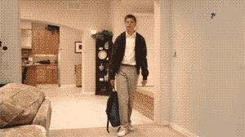
THAT’S A LOT…

Slide 6
BUT HERE’S THE BIG OPPORUNITY:

Slide 9
THAT’S A LOT OF MONEY,
BUT NOT A LOT OF NEW DONORS
IMAGINE IF WE GOT THAT NUMBER TO GROW PROPORTIONATELY WITH THE FUNDS RAISED?

Slide 10
LET’S TALK EMAIL!
How many of you email donors the day of the ExtraGive?
How many email multiple times a day?
Are you using tools to send?

Slide 11
LET’S TALK EMAIL!
Ideas to guide your emailing:
Set a goal! Let your donors know ahead of time what you’re shooting for
Send a “the ExtraGive starts now!” email at midnight (schedule ahead of time)
Send a mid-day email updating donors on your progress towards the goal
Or, a “final hours” email (if you’re really close!)

Slide 12
LET’S TALK EMAIL!
USE YOUR DONOR LIST
Keep downloading the updated donor list and reach out quickly with a personalized thank you

Slide 13
LET’S TALK EMAIL!
USE YOUR DONOR LIST
They’ve already given, so give them the chance to be your cheerleaders:
Incentivize them to tell their friends why they gave (graphics, etc.)
Invite them to share with you why they gave
(You can use it for other things!)
Run a contest and give away swag bags to someone who shares!

Slide 14
LET’S TALK EMAIL!
Eternal ground rules for emailing:
SUCCINT
Ditch the flowery text and speak directly
PERSONAL
Use mail merge or other features to make sure their first name is in the salutation or subject line
IMAGES (or movement)
Show, don’t tell.

Slide 15
LET’S TALK SOCIAL MEDIA!
#ExtraGive: appeared on 4.2 million timelines, “reached” 2.2 million
#IGiveExtra: appeared in 400,000 timelines, “reached” 141,000
#ExtraGive: 170,000 impressions; 6,000 likes, 200 posts
#IGiveExtra: 127,000 impressions; 5,200 likes; 200 posts
IGiveExtra social stream: 7.4 million impressionss

Slide 16
LET’S TALK SOCIAL MEDIA!
Organic reach is
But how do you get it?

Slide 17
LET’S TALK SOCIAL MEDIA!
Remember social media is a telephone, not a megaphone!
Don’t just say: ask, celebrate, converse, engage
Speak authentically and use your “voice”
Use images and videos
Some social networks prioritize that content (Facebook)

Slide 18
LET’S TALK SOCIAL MEDIA!
Give your audience WHAT THEY NEED
“We want a piece of content (graphic, brochure, etc.) for ____"

Slide 19
LET’S TALK SOCIAL MEDIA!
Give your audience WHAT THEY NEED
“Our audience needs ___ to know our why, so they’ll give."

Slide 20
LET’S TALK SOCIAL MEDIA!
Show don’t tell (Facebook wants you to, too)
Make graphics
Make videos
Go “live”
Sometimes too polished isn’t good!
(Videoleap)

Slide 21
LET’S TALK SOCIAL MEDIA!
Work on building your audience now , so you’re ready to roll on November 17!
Look for people who follow/like orgs (locally or nationally) that are similar to you—make sure they know you’re participating in the ExtraGive!
Identify influencers
Maybe approach a local person of note and do a social media takeover for the day?
Remember, engage!

Slide 22
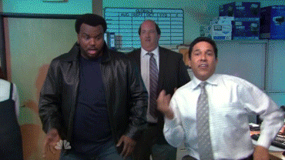
LET’S TALK EVENTS!
Are you holding an event on (or before) November 17?

Slide 23
LET’S TALK EVENTS!
Creating events are easy, holding engaging events are hard(er)!
You could make it pop-up and spontaneous
Do a group activity or create something together
Make it public and open

Slide 24
LET’S TALK EVENTS!
You don’t have to do it alone!
Approach a business about hosting you
Use custom H&H merch to brand the event
Partner up with another org! (And submit for the new prize!)

Slide 25
DON’T BE AFRAID TO GO OLD SCHOOL

Slide 26
DON’T BE AFRAID TO GO OLD SCHOOL
We’re bombarded with content, emails, and ads constantly
A personalized, physical take-away might be your best play!
Use geography to your advantage: “we’re right down the street!”

Slide 27
DON’T BE AFRAID TO GO OLD SCHOOL
Street teams
Take to the streets and generate hype about your organization
Create mini-cards to give out to potential donors so they remember you that has a fun (or funny) message on it. Get creative!

Slide 28
DON’T BE AFRAID TO GO OLD SCHOOL
Call on your influencers…literally!
Reach out (phone, get coffee, etc.) with some of your biggest boosters and ask them if they’ll help get the word out
It’s not a “second ask”, it’s an invitation to join the team

Slide 29
WHEW…
…how are you doing?

Slide 30
DON’T GO TO SLEEP YET!
ExtraGive doesn’t end at 12:00 on 11/18!
Make sure you’re THANKING and FOLLOWING UP with everyone who helped make your day such a success!
Work on building your relationship the rest of the 364 days; ask them to share their stories

Slide 31
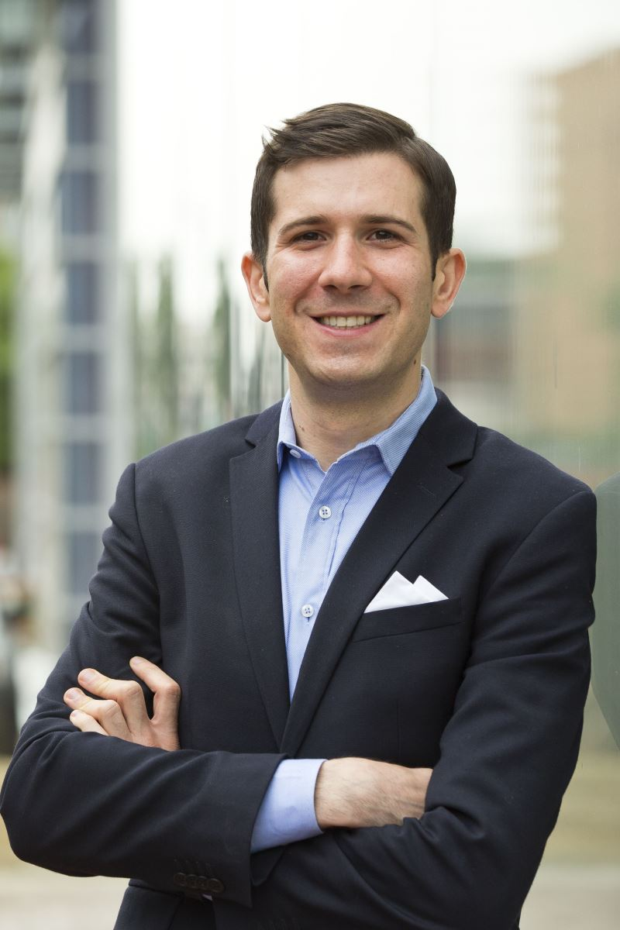
SO LET’S REVIEW…
Remember John Trybus’ guidance:
Tell your stories in a compelling way
Ditch the elevator speech, focus on the big ideas that create emotional connections

Slide 32
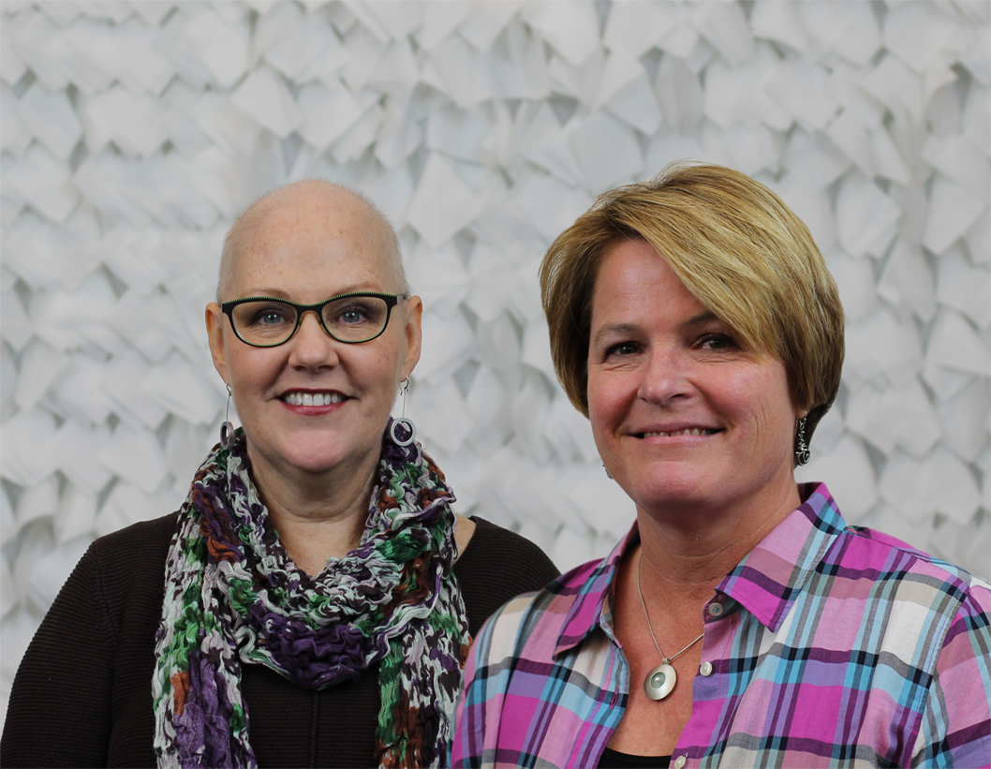
SO LET’S REVIEW…
Remember Lydia Henry & Tricia Fackler’s guidance:
Think about how to disrupt conventions with your events. Get creative!
…have a fire plan!

Slide 33
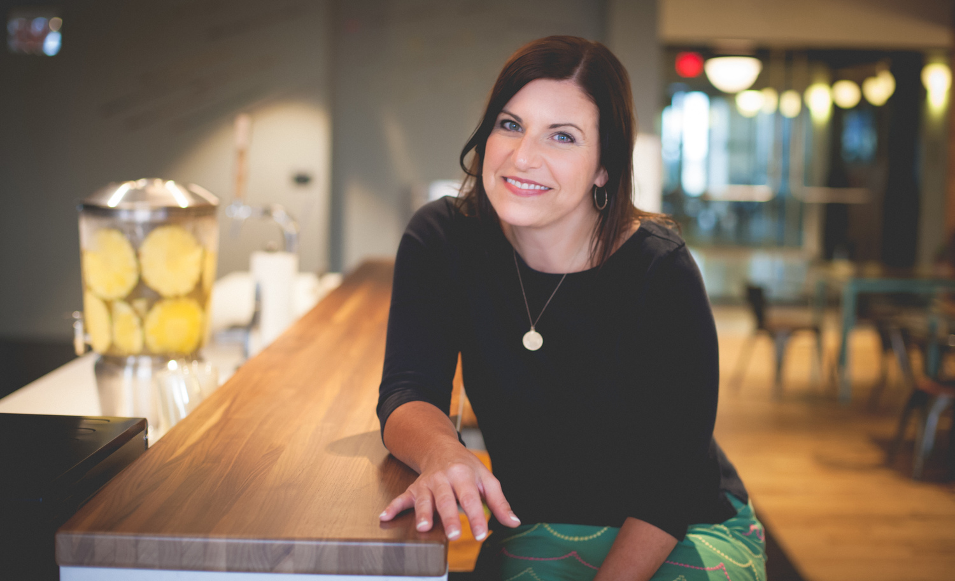
SO LET’S REVIEW…
Remember Rachel Muir’s guidance:
Get your whole staff engaged
Work towards cementing your culture of philanthropy

Slide 34
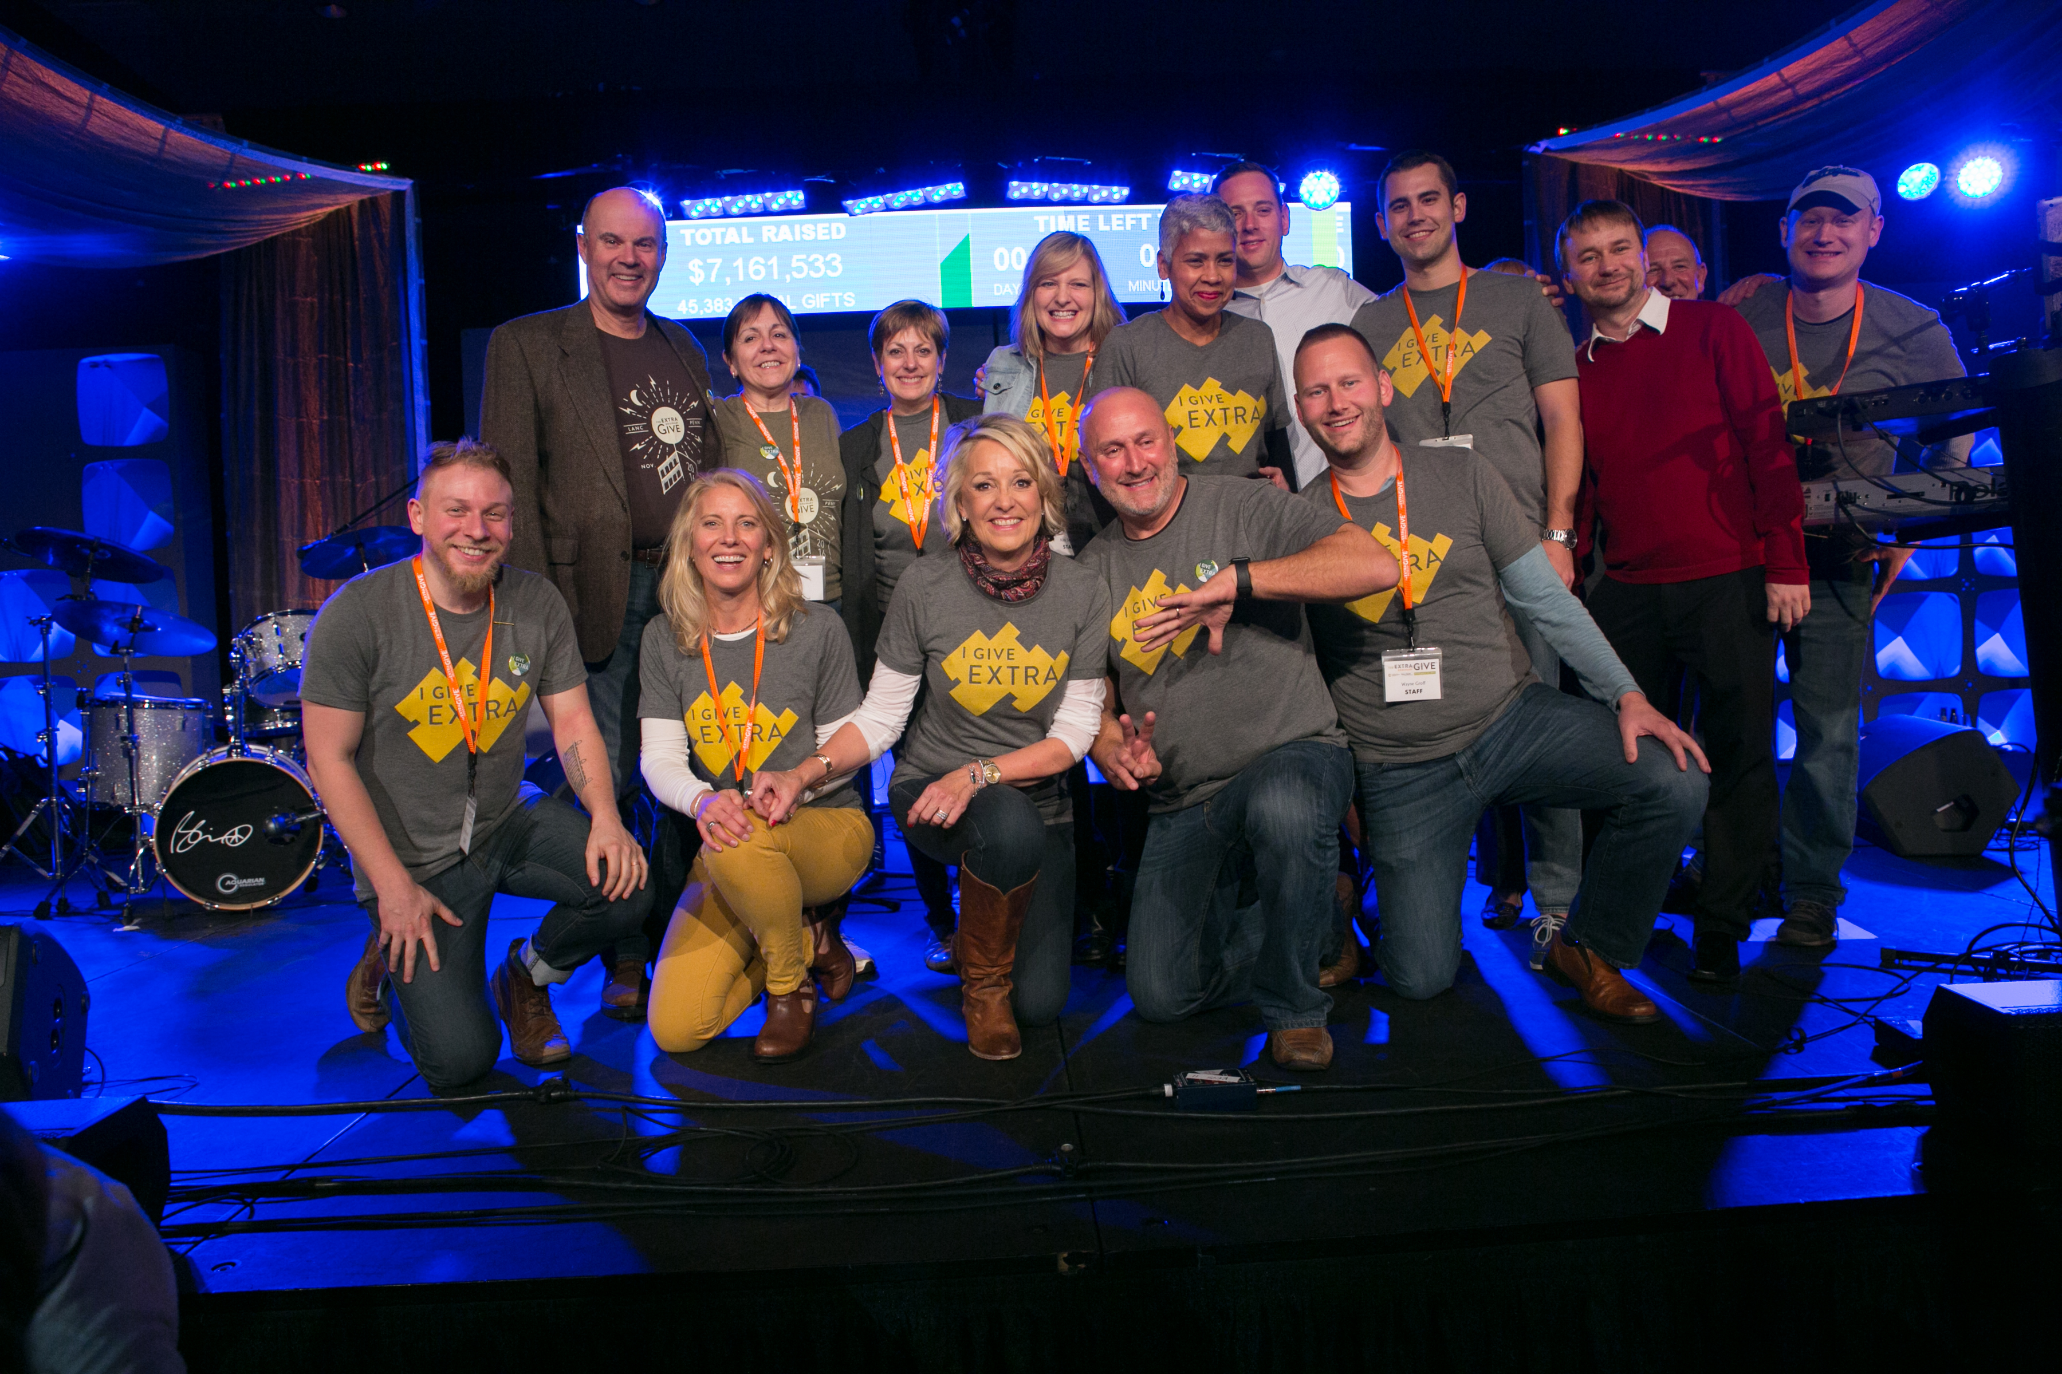
SO LET’S REVIEW…
Remember like, 40 minutes ago:
Keep in mind how people are engaging with your brand
Live your “why” at every level of your marketing and contact, ESPECIALLY afterward
Keep checking the toolkit!

